Slide 1



www.Games4esl.com
Ready to use ESL activities for busy English Teachers
www.YouTube.com/Games4esl
Visit us on YouTube to see our FREE, FUN, and ENGAGING, ESL Games and Activities.
Click Here:

Slide 2
SPACE RACE
How to Play:
-Make 2 teams
-One team is the ‘Rocket’ and one team is the ‘Alien Ship’
- The teams take turns in choosing a letter and then answering the question.
After answering the question, click on the Rocket / Alien Ship and it will move.
The first team to arrive at Mars is the winner.

Slide 3



SPACE RACE
Choose One:
Rocket Ship or Alien Ship?

Slide 4

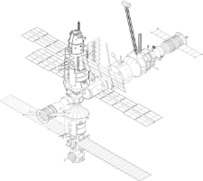




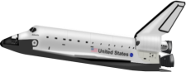




SPACE RACE
GO!
3
2
1
ROCKET SHIP WINS!
ALIEN SHIP
WINS!

Slide 5



SPACE RACE
1
2
3
4
5
6
7
8
9
10
11
12
13
14
15
16

Slide 6

QUESTION
ANSWER

Slide 7
QUESTION
ANSWER

Slide 8
QUESTION
ANSWER

Slide 9
QUESTION
ANSWER

Slide 10
QUESTION
ANSWER

Slide 11
QUESTION
ANSWER

Slide 12
QUESTION
ANSWER

Slide 13
QUESTION
ANSWER

Slide 14
QUESTION
ANSWER

Slide 15
QUESTION
ANSWER

Slide 16
QUESTION
ANSWER

Slide 17
QUESTION
ANSWER

Slide 18
QUESTION
ANSWER

Slide 19
QUESTION
ANSWER

Slide 20
QUESTION
ANSWER

Slide 21
QUESTION
ANSWER

Slide 22
QUESTION
ANSWER

